Slide 1


Technology Driven Active Learning in Human Anatomy Laboratory 1.0
Team Member(s): Darian Mendez, Hector Cen Product Owner(s): Lisa Brinn
Instructor: Masoud Sadjadi School of Computing and Information Sciences Florida International University
Final Presentation
Advanced Software Engineering/Senior Projects Fall 2016
Notes:
7 seconds.
Greet your audience, thank them for attending your presentation, introduce yourself, introduce your project, introduce your team members, and quickly indicate what each of you did in a high-level manner, and put more emphasis on your part/contribution.

Slide 2
Problem definition
Anatomy models access is limited to the classroom’s availability
Existing laboratory manuals are not in sync with class materials
Students spend a lot of time taking photos of the plastic models
Notes:
10 seconds.
Introduce the problem that the whole project (in all versions) tackles with GIF or screenshot.

Slide 3
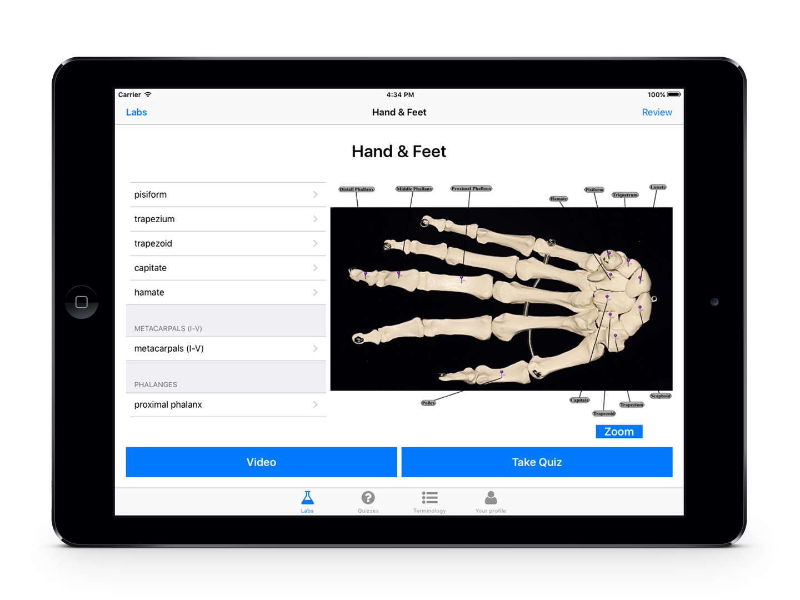
Solution
The proposed solution consist of an interactive, media-rich, laboratory manual in the form of an iPad app
The app contains features that will enrich the student’s learning experience through a highly collaborative environment.
Notes:
10 seconds.
Introduce the problem that the whole project (in all versions) tackles with GIF or screenshot.

Slide 4
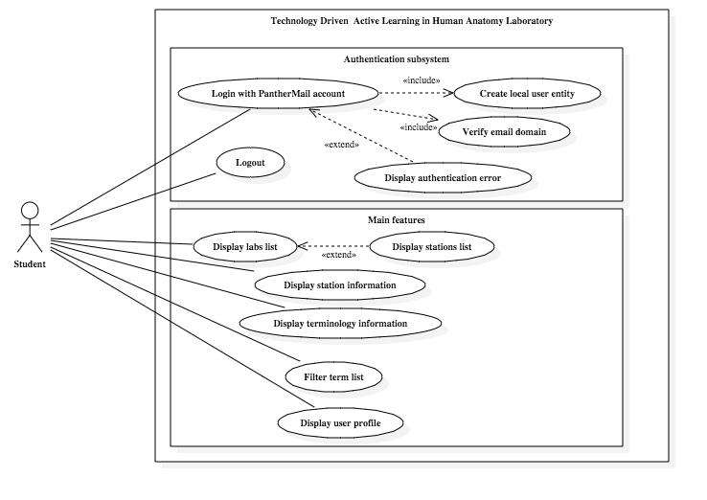
Requirements: Use Cases
Notes:
10 seconds.
Introduce the problem that the whole project (in all versions) tackles with GIF or screenshot.

Slide 5
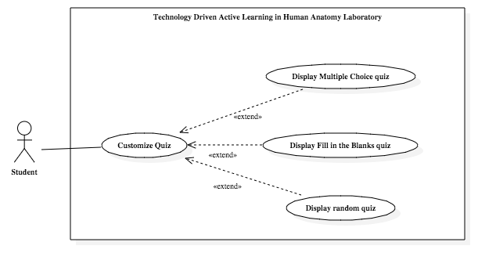
Requirements: Use Cases
Notes:
10 seconds.
Introduce the problem that the whole project (in all versions) tackles with GIF or screenshot.

Slide 6
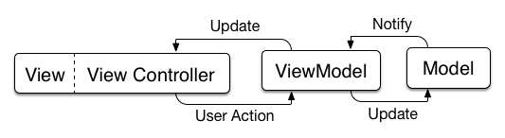
System Design: Architecture
MVVM: Model-View-Viewmodel
Notes:
10 seconds.
Introduce the problem that the whole project (in all versions) tackles with GIF or screenshot.

Slide 7
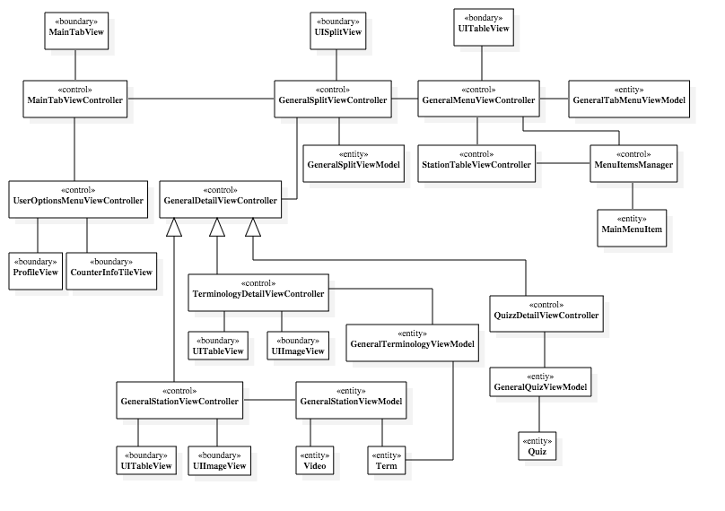
Minimal Class Diagram
Notes:
10 seconds.
Introduce the problem that the whole project (in all versions) tackles with GIF or screenshot.

Slide 8
User Stories
#120: Display popup to select station
#121: Load Lab 1 information
#125: Display station information
#129: Load and play station videos
#130: Allow login through PantherMail
#132: Load station information in detail view controller
#176: Personalize the quiz settings
#177: Save student’s information in a local database
#179: Display a student profile view
#184: Zoom in the picture of the terms
Notes:
10 seconds.
Introduce the problem that the whole project (in all versions) tackles with GIF or screenshot.

Slide 9
User Story #132
Description
As a teacher I would like the students to have a full view with the information of the selected station so they can learn and practice the lab.
Acceptance criteria
The detail view is populated with the list of terms that belongs to the station.
When users tap on a term in the list, the app should update the ImageView next to the terminology list and show an image related to the term.
Tasks
Add a ImageView to show an image associated to the term selected by the user.
Add a TableView.
Add images for Station 1 of Lab 1.
Add station terminology list to detail view.
Notes:
10 seconds.
Introduce the problem that the whole project (in all versions) tackles with GIF or screenshot.

Slide 10
User Story #176
Description
As a student I want to change the settings of my quizzes so that I can take quizzes with time limits, quizzes for specific stations or labs.
Acceptance criteria
The student can change the time limit of the quiz.
The student can select to take the quiz of one station or multiple stations in one quiz.
The student can take the quiz for one lab or multiple labs in one quiz.
The student can choose to take it multiple choice, fill in the blank or both.
Notes:
10 seconds.
Introduce the problem that the whole project (in all versions) tackles with GIF or screenshot.

Slide 11
Test case: Sunny day
Test case ID: US_130_001
Test Description: Ensure that the student can login through FIU its assigned email address.
Pre-condition: Student is logged out of the application. Login view is shown in the app.
Test Steps: The user taps the "Login with your PantherMail account " button on the center of the login view controller. On the web view with Google Sign in flow, the user enters his / hers panther mail credentials.
Expected Result: The login view controller gets dismissed and the app shows the detail view controller of the "Labs" tab, this is the default behavior. It also shows the user full name in the bottom right of the detail view controller.
Actual result: PASS
Notes:
10 seconds.
Introduce the problem that the whole project (in all versions) tackles with GIF or screenshot.

Slide 12
Test case: Rainy day
Test case ID: US_130_002
Test Description: Ensure that the student cannot login through another Google account.
Pre-condition: Student is logged out of the application. Login view is shown in the app.
Test Steps: The user taps the "Login with your PantherMail account " button on the center of the login view controller. On the web view with Google Sign in flow, the user enters his / hers personal Gmail credentials.
Expected Result: The app displays a popup warning the user that only accounts belonging to "fiu.edu" domain are allowed to authenticate in the application.
Actual result: PASS
Notes:
10 seconds.
Introduce the problem that the whole project (in all versions) tackles with GIF or screenshot.

Slide 13




Summary
The iPad application for the Human Anatomy Lab will greatly improve the student’s learning process.
Additionally, it will relieve them of the time and location constraints for access to course materials.
It will also provide them with knowledge assessment methods in order to improve their readiness for a test.
Notes:
10 seconds.
Introduce the problem that the whole project (in all versions) tackles with GIF or screenshot.

Slide 14
Contact
You can reach us at:
Hector Cen:
hcen001@fiu.edu
github.com/zentraedi
linkedin.com/in/hectorcen
Darian Mendez:
dmend078@fiu.edu
github.com/dmend078
Notes:
10 seconds.
Introduce the problem that the whole project (in all versions) tackles with GIF or screenshot.

Slide 15
Thank you! Questions?
Notes:
10 seconds.
Introduce the problem that the whole project (in all versions) tackles with GIF or screenshot.

